Slide 1
Predictive Maintenance of Industrial Machinery
CAPSTONE PROJECT
Presented By:
1. Student Name- Abhay Tripathi
2.College- University of Lucknow
3.Branch-Computer Science & Engineering
4.Student Id-STU68334921878d11748191521

Slide 2
OUTLINE
Problem Statement (Should not include solution)
Proposed System/Solution
System Development Approach (Technology Used)
Algorithm & Deployment
Result (Output Image)
Conclusion
Future Scope
References

Slide 3
Problem Statement
Develop a predictive maintenance model for a fleet of industrial machines to anticipate
failures before they occur. This project will involve analyzing sensor data from machinery
to identify patterns that precede a failure. The goal is to create a classification model that
can predict the type of failure (e.g., tool wear, heat dissipation, power failure) based on
real-time operational data. This will enable proactive maintenance, reducing downtime
and operational costs

Slide 4
Proposed Solution
1. *Data Collection:* Collect sensor data from machines, including temperature, vibration, pressure, and power consumption.
2. *Data Preprocessing:* Clean and preprocess data, handling missing values and normalizing/scale data.
3. *Feature Engineering:* Extract relevant features from sensor data, such as time-domain and frequency-domain features.
4. *Model Training:* Train a classification model using machine learning algorithms, such as Random Forest or Convolutional Neural Networks.
5. *Model Deployment:* Deploy the model in a production-ready environment, integrating with real-time data streams from machines.
6. *Model Monitoring:* Continuously monitor model performance and update as needed.
Benefits:*
1. *Reduced Downtime:* Predict potential failures before they occur, enabling proactive maintenance.
2. *Cost Savings:* Minimize emergency repairs and reduce waste.
3. *Improved Efficiency:* Optimize machine performance and reduce energy consumption.

Slide 5
System Approach
Data Collection*: Sensors and IoT devices continuously monitor equipment conditions such as temperature, vibration, pressure, and other relevant parameters.
- *Data Processing & AI Analysis*: Machine learning models analyze collected data to detect anomalies and predict potential failures. AI-powered algorithms identify patterns and trends that can lead to equipment failure.
- *Predictive Alerts*: The system sends alerts to maintenance teams before an issue escalates, allowing for proactive maintenance and minimizing downtime.
- *Condition-Based Monitoring*: Maintenance is scheduled only when necessary, reducing costs and downtime.

Slide 6
Algorithm & Deployment
Algorithm Development
1. *Data Collection*: Gather sensor data from industrial machinery, including temperature, vibration, and pressure readings.
2. *Data Preprocessing*: Clean and preprocess the data, handling missing values and normalizing/scale data.
3. *Feature Engineering*: Extract relevant features from sensor data, such as time-domain and frequency-domain features.
4. *Model Training*: Train a machine learning model using algorithms like Random Forest, Support Vector Machine (SVM), or Convolutional Neural Networks (CNN).
Deployment on IBM Cloud
1. *IBM Cloud Pak for Data*: Use IBM Cloud Pak for Data to build and deploy a predictive maintenance scheduling solution.
2. *Edge Deployment*: Deploy data reduction algorithms on edge devices using Simulink Coder and MATLAB Production Server.
3. *Cloud Deployment*: Deploy machine learning models on IBM Cloud, using cloud-based services like IBM Watson Studio and IBM Cloud Functions.
4. *Monitoring and Feedback*: Monitor model performance, update models as needed, and incorporate feedback from users and maintenance personnel.

Slide 7
Result
https://github.com/bhargav-abhay/Predictive-Maintenance-of-Industrial-Machinery

Slide 8
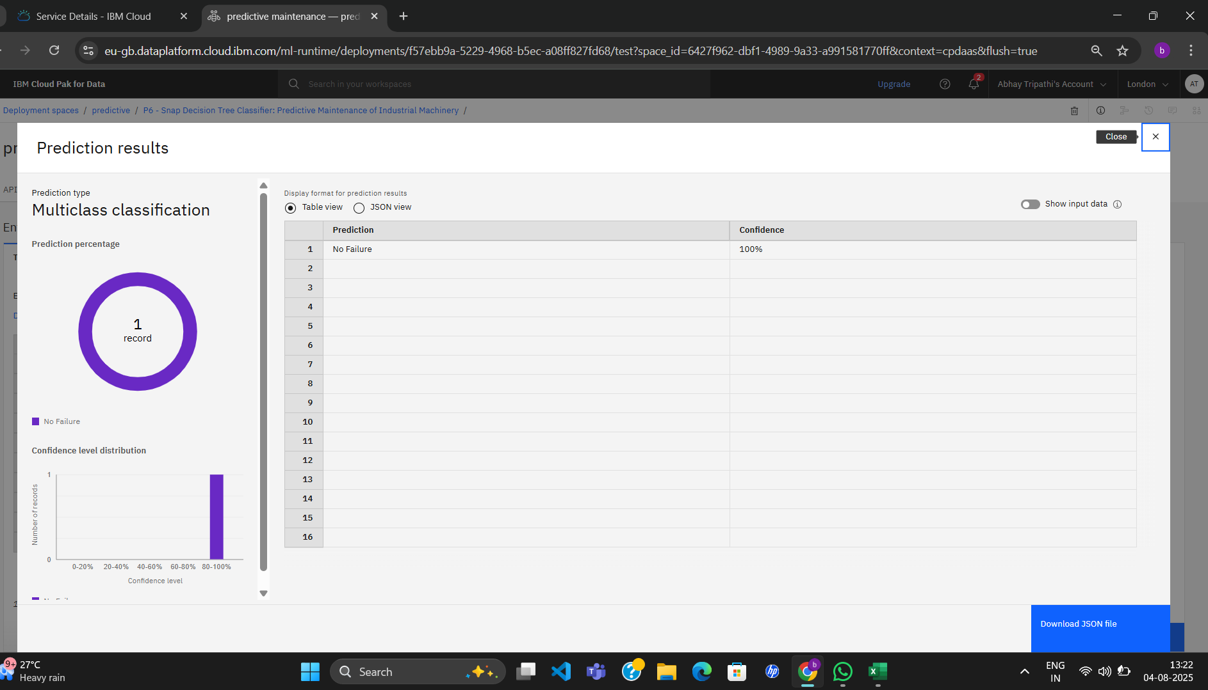

Slide 9
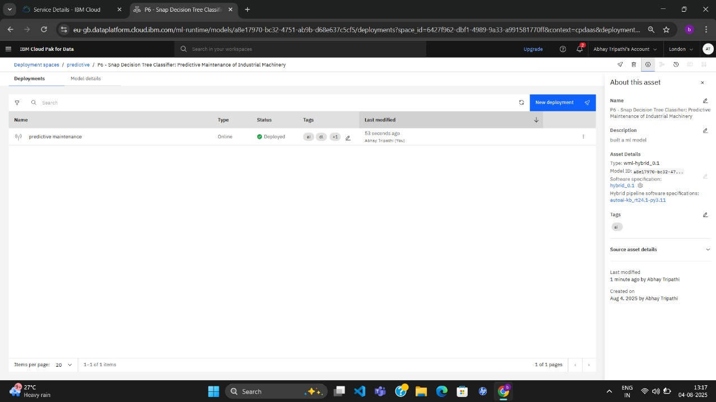

Slide 10
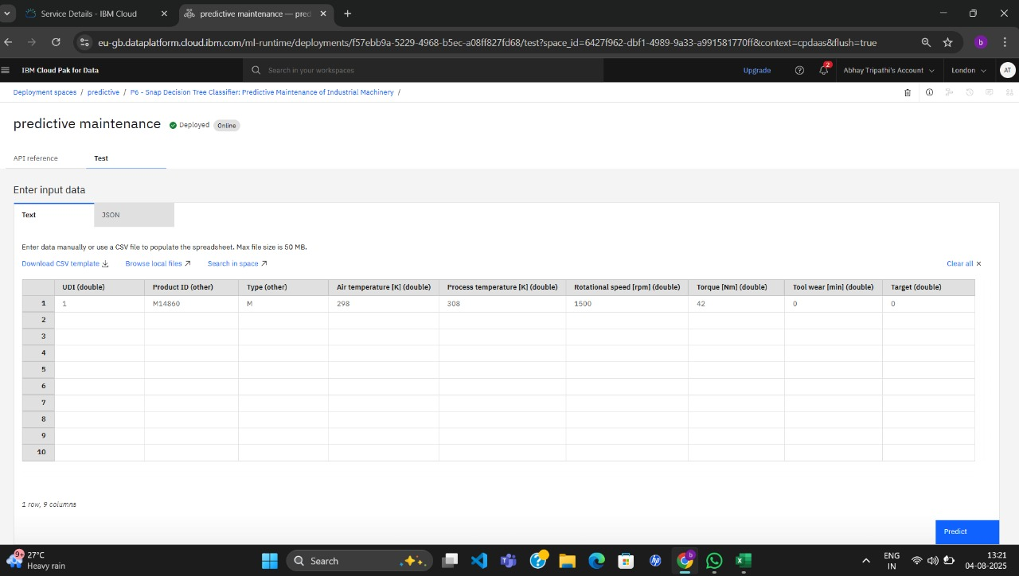

Slide 11
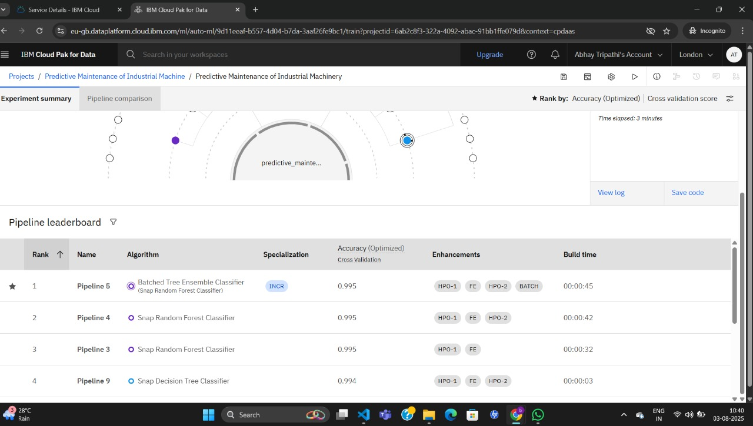

Slide 12
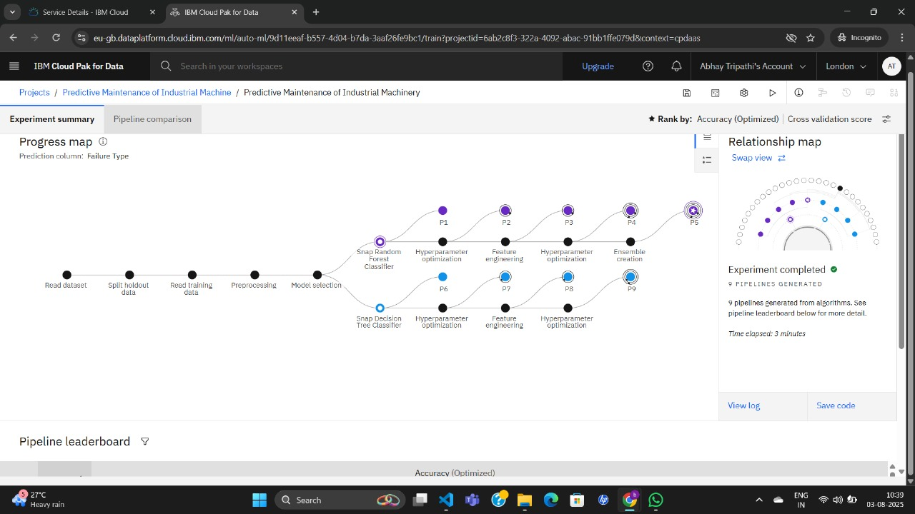

Slide 13
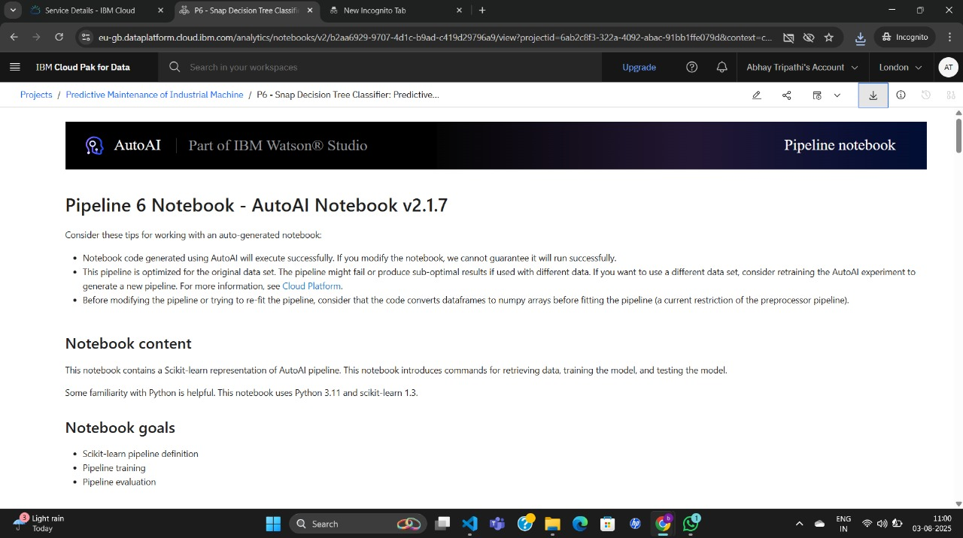

Slide 14
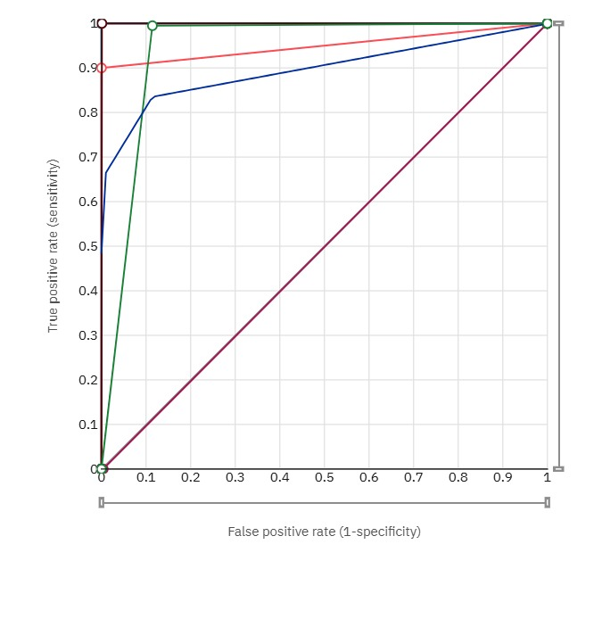

Slide 15
Conclusion
Predictive maintenance optimizes equipment performance, reduces downtime and costs, and improves efficiency through machine learning algorithms and scalable IBM Cloud deployment, enabling industries to stay competitive and achieve operational excellence.

Slide 16
Future scope
The future scope of predictive maintenance includes integrating AI, IoT, and edge computing to further enhance predictive accuracy and enable real-time decision-making, driving increased efficiency, reduced costs, and improved asset reliability across industries, while also enabling proactive maintenance, minimizing downtime, and optimizing resource allocation.

Slide 17
References
1. *IBM*: IBM Cloud Pak for Data, IBM Watson Studio, IBM Maximo
2. *Research Papers*:
- "Predictive Maintenance using Machine Learning" by IEEE
- "A Survey on Predictive Maintenance for Industrial Equipment" by Elsevier
3. *Industry Reports*:
- "Predictive Maintenance Market Research Report" by MarketsandMarkets
- "Industrial IoT and Predictive Maintenance" by McKinsey
4. *Online Resources*:
- Predictive maintenance articles on IBM.com
- Predictive maintenance blogs on LinkedIn

Slide 18
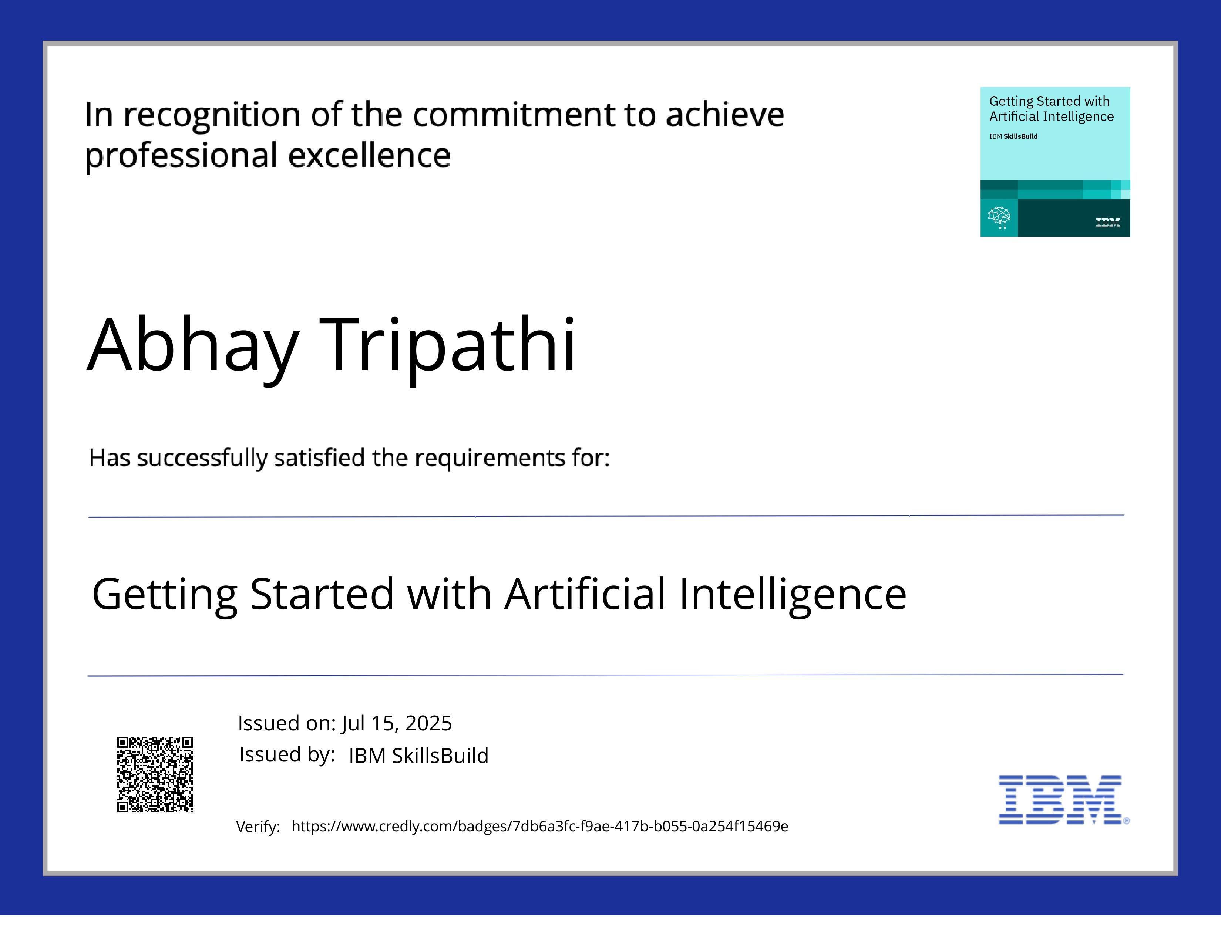
IBM Certifications

Slide 19
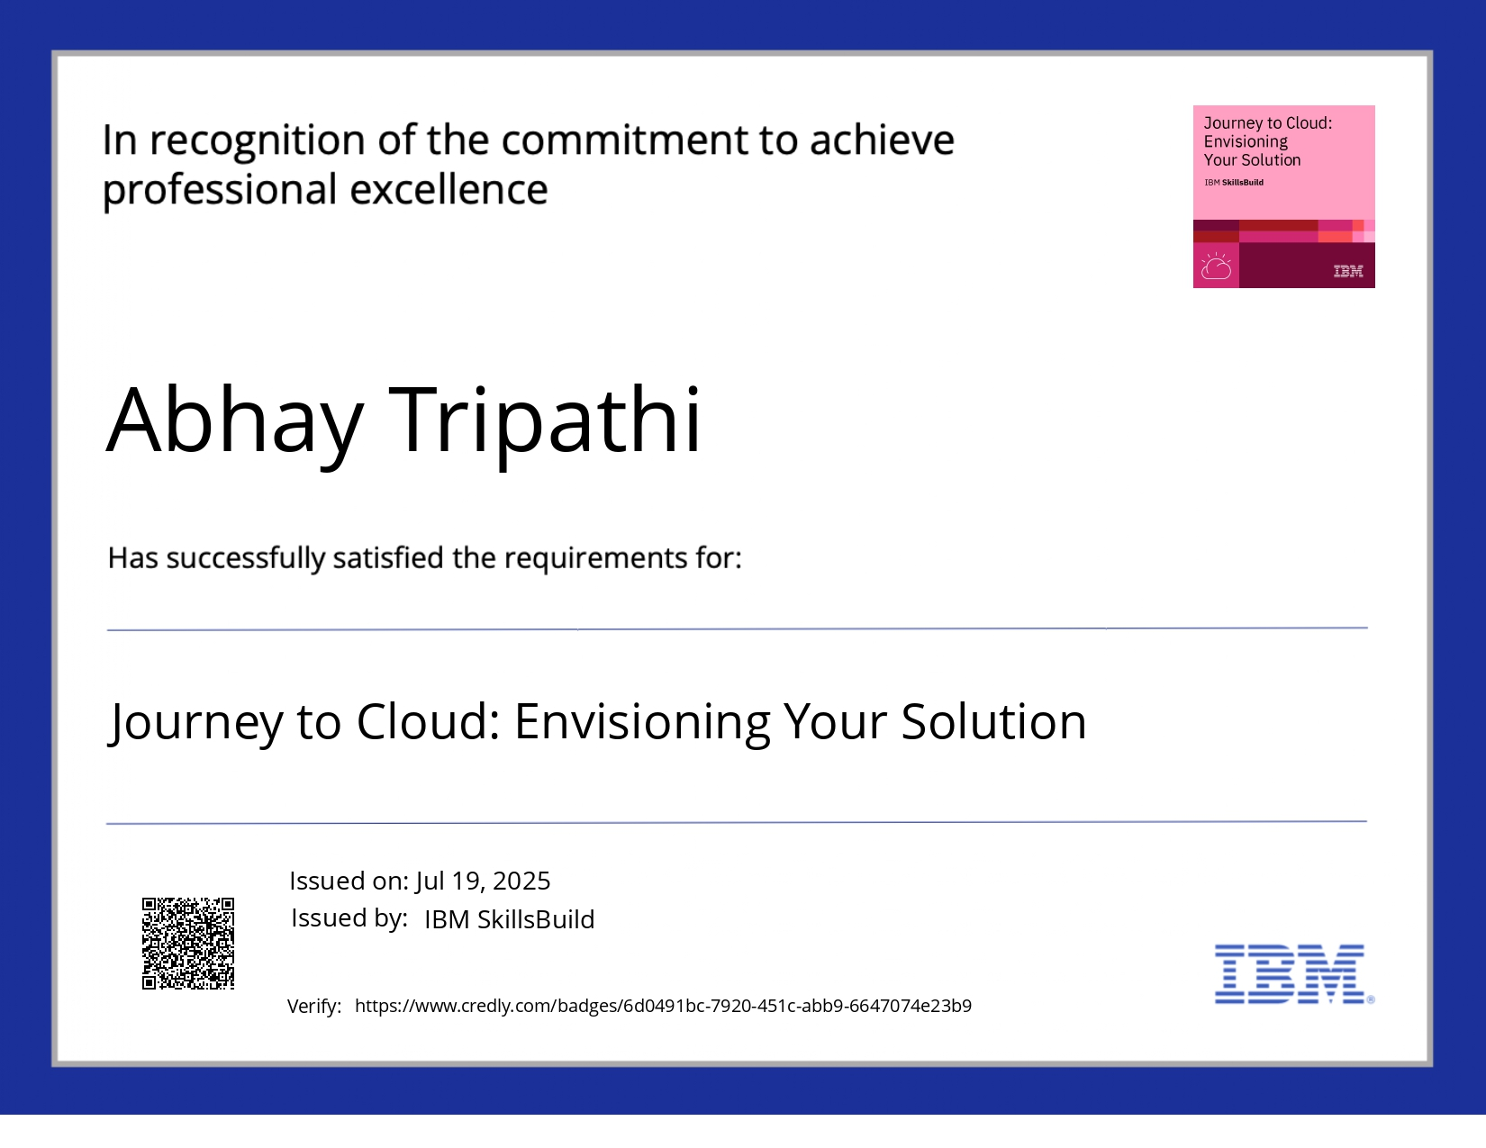
IBM Certifications

Slide 20
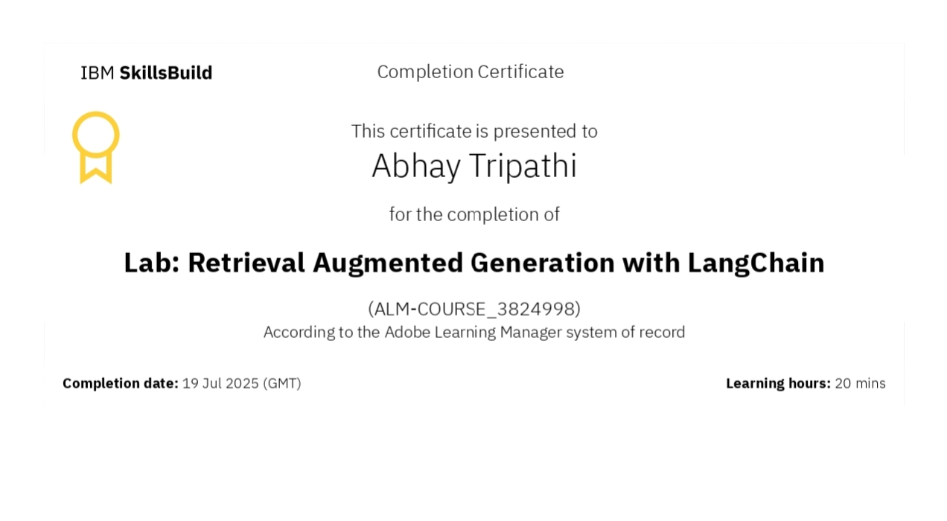
IBM Certifications
Screenshot/ credly certificate( RAG Lab)

Slide 21
THANK YOU

